Slide 1
Achievements
Childline 10-9-8:
Emergency Outreach Services

Slide 2
CHILDLINE 10-9-8
CHILDLINE is India’s first & only 24-hour, free, emergency phone outreach service for children in crisis
Tele-outreach model: Western models are predominantly Tele -counseling helplines
World’s largest - emulated in over 43 countries
Notes:
2

Slide 3
Unique Partnership
Single largest Govt-NGO Partnership: Ministry of Women & Child Development (GoI) supported government - civil society Partnership Model
Implemented through Social franchising: anchored by Childline India Foundation (CIF) & implemented by district/city based organisations
Engagement with State & District level administration
State-of-the-art technology through partnership with telecom & technology industry

Slide 4
Childline India Foundation (CIF)
Services provided through - network of community based, non-governmental organisations
CIF is responsible for:
  Establishing CHILDLINE services nationally
  Ensuring quality of service
  Monitoring & handholding of services/partners
  Grant disbursement
  Training, research & documentation
  Awareness & advocacy
  Additional resource generation
Childline (1098) services are facilitated & monitored – by a mother NGO under - Integrated Child Protection Scheme (ICPS)

Slide 5
Milestones
1996: TISS project in Mumbai
1998: expanded reach under Ministry of Social Justice & Empowerment’s (MSJE) street children scheme
1999: Transfer to CIF
2006: Transfer to MWCD –
CIF as ‘mother NGO’
26th November, 2007: shift to centralized model as a pilot (CCC) 2 seats at TCS, Mumbai - Coverage Thane city
2009-10: Integration into Integrated Child Protection Scheme
1996 – 2014: from a university project to a National child protection service

Slide 6
Landmark
Jan 2011:
  First Centralised Contact Centre (CCC) becomes functional with 14 seats
  75 cities of North & west connected in Jan 2011
  1098 commences as Cat 1 number
    Unrestricted access
    Toll free
    called party pays

Slide 7
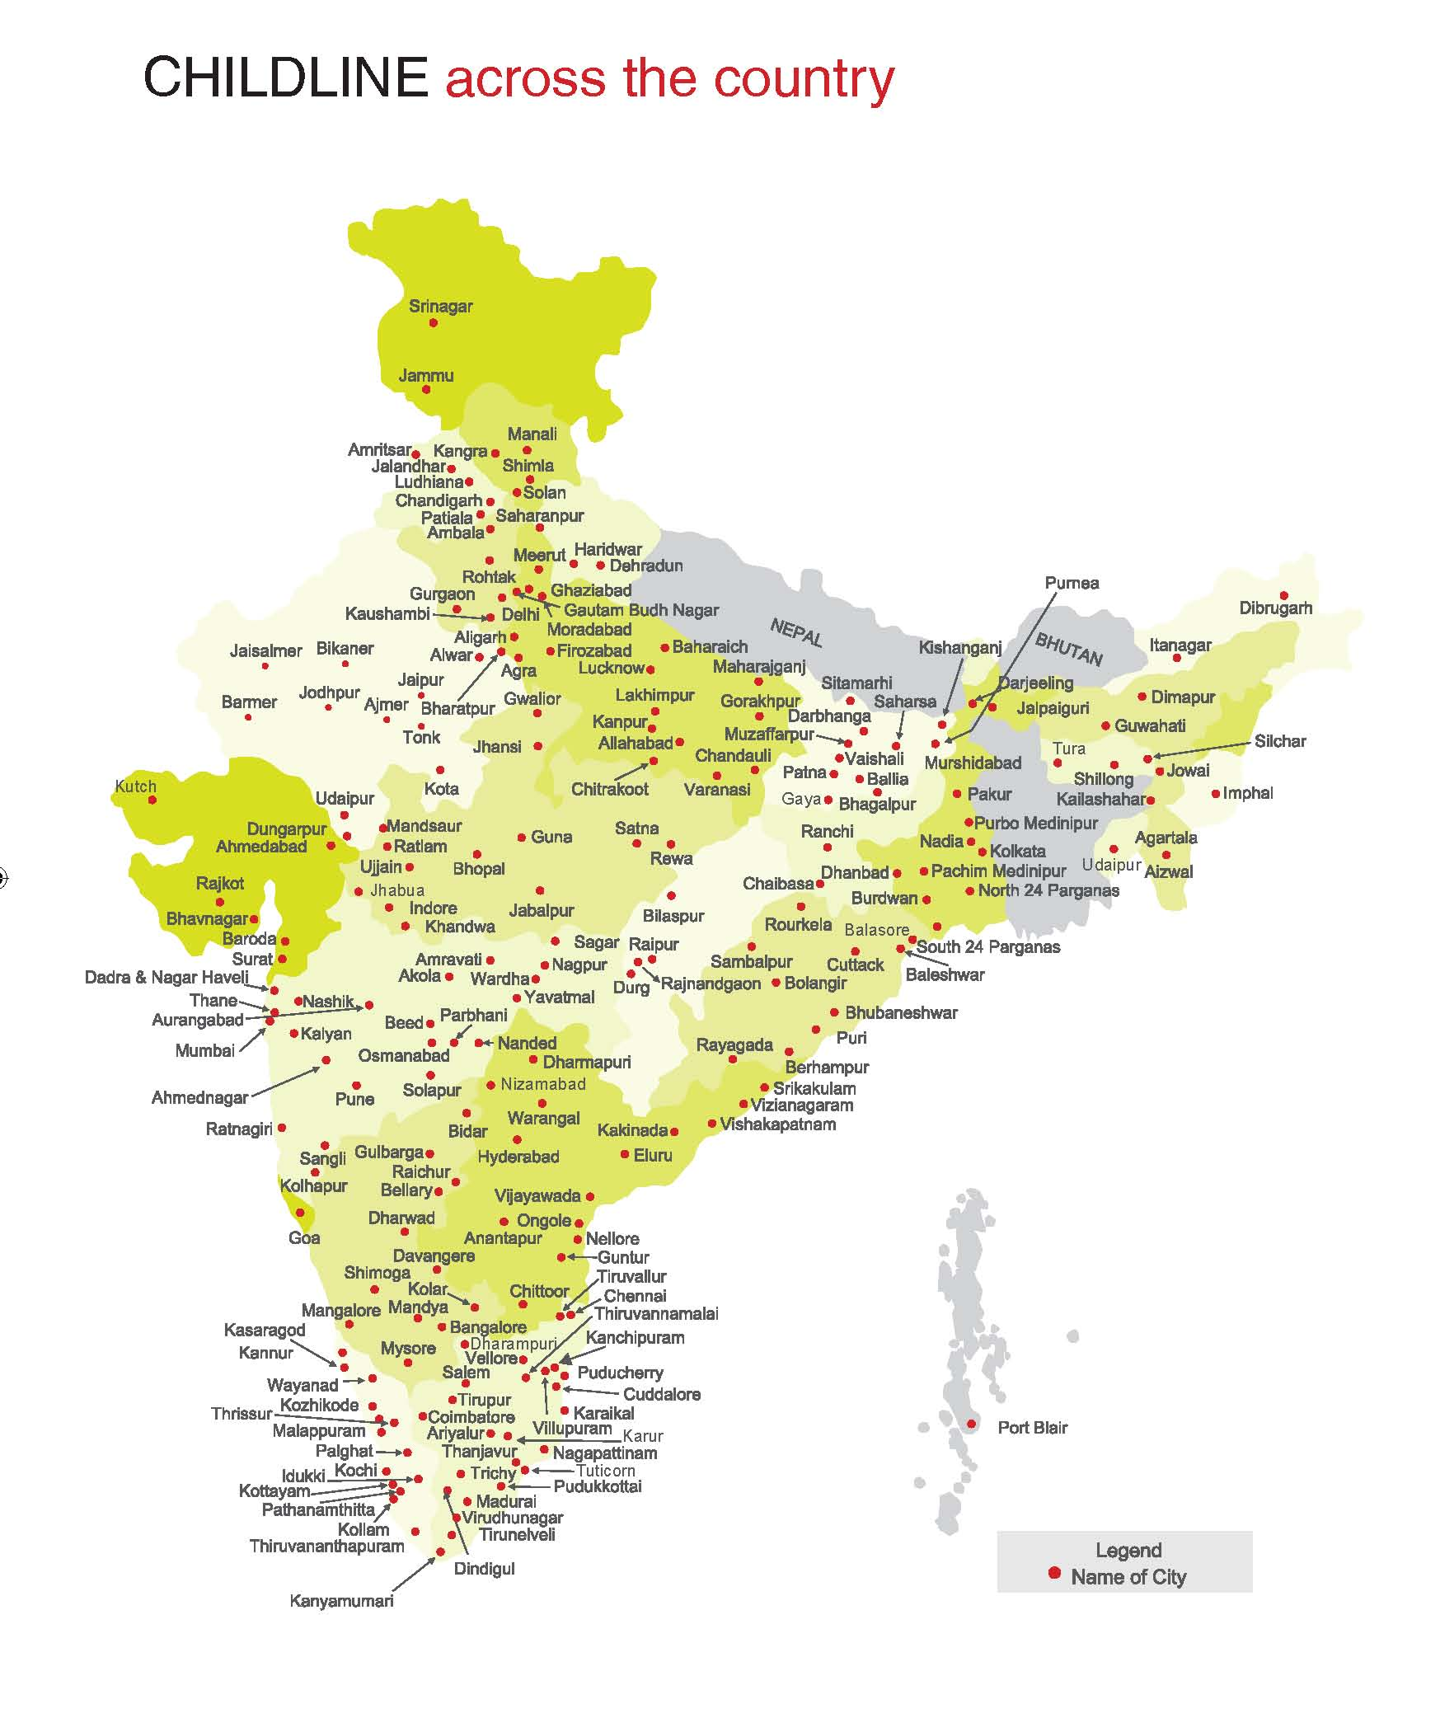
December 2014
282 locations -
174 urban, 108 rural
543 partners – Nodal, Collaborative, Support & Sub-centres
147.87 lakh calls in the past 5 yrs
38 lakh calls in 2013-14
CCC covering all locations
Intervention response in 25 languages

Slide 8
Year wise growth of CHILDLINE Locations

Slide 9
Children provided services by
CHILDLINE 1098
Children living on the streets
Addicted to substance
Children needing medical help
Missing children
Victims of trafficking/abuse
Mentally ill children
Children forced into labour/begging
HIV/AIDS infected/affected children
Differently-abled children
Children forced into marriage
Children in conflict with law
Children affected by disaster/armed conflict
Notes:
9
Street children are the single biggest segment of callers on 1098.

Slide 10
Intervention Model
Provide SOS assistance: food, medical help, temporary shelter etc.
Link with police
Incoming calls to 1098
File FIR if needed
Call Response @ CCC
Calls requiring intervention handed over to City Intervention Units
Produce cases before CWC
Assist in implementing
CWC order
Information calls:
handled by Contact
Centre staff
Link to counseling, health, shelter, other services

Slide 11
Intervention cases breakup

Slide 12
Listening to Children & Awareness activities
Open House – an open forum for children
  To voice their issues and problems
  To evaluate the service
  To involve allied systems in CHILDLINE
  Once every quarter in each CHILDLINE city
Outreach
  Year-round partner activity
  Annual CHILDLINE Se Dosti campaign
  Sensitization in schools through volunteers
  Signage: public spaces, text books

Slide 13
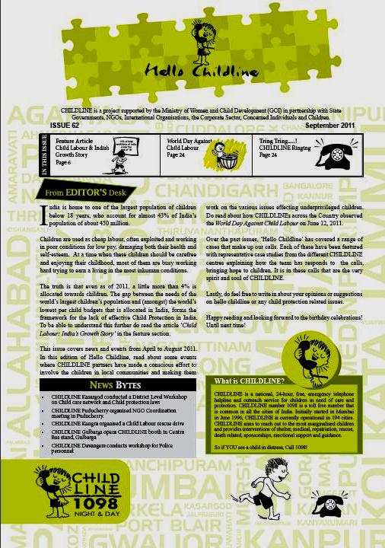

Hello Childline
Initiatives to involve all stakeholders to be part of CHILDLINE as “CHILDLINE dost”

Slide 14
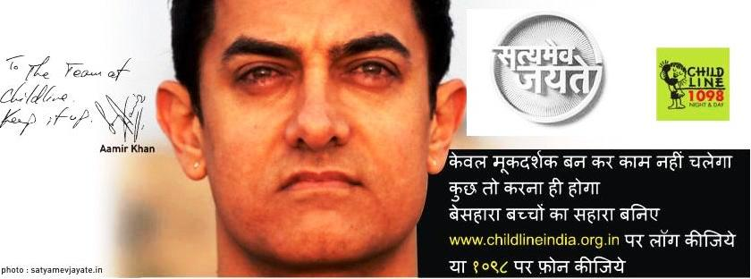
Celebrity endorsement for CHILDLINE service & huge increase in calls

Slide 15

Reaching out through Electronic Media
With the support of Channel [V] we shared some of our live cases to sensitize society on child protection issues

